Slide 1


Grocery Store Management

Slide 2
Objective of the Project
To design and implement a relational database for a grocery store.
To retrieve and manipulate data using SQL queries.
To perform data analysis for business insights such as top customers, best-selling products, and revenue trends.
To practice using joins, aggregations, subqueries, and filtering techniques.

Slide 3
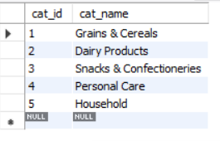
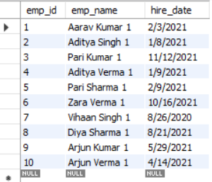
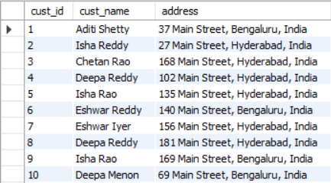
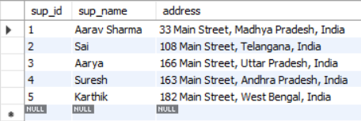
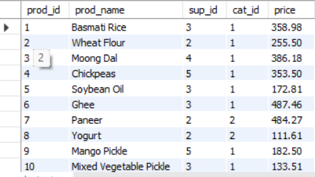
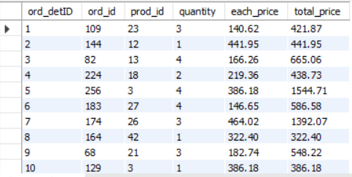
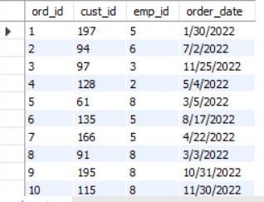
Tables
Categories Table
Employees
Customers Table
Suppliers
Products Table
Order details
Orders Table

Slide 4
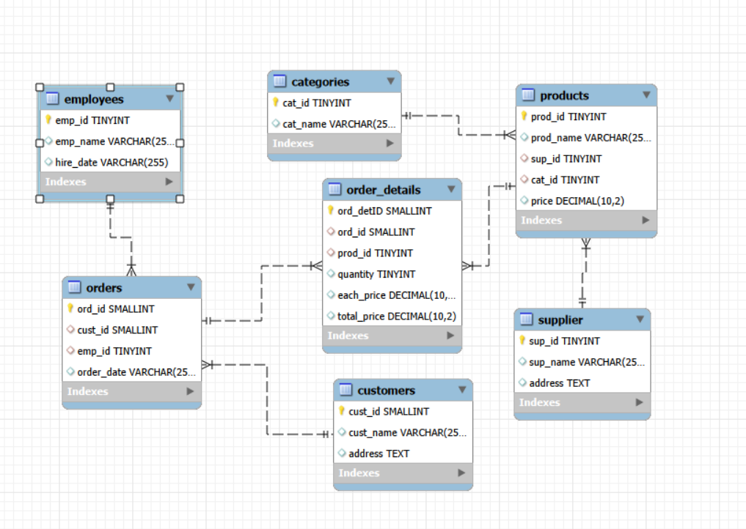
• ER Diagram and schema explanation
One-to-many relationships :
Supplier to products
Categories to products
Employees to orders
Customers to orders
Order Connections:
Products to Order details
Orders to order details
Employees & Customers :
Employees to orders
Orders to Customers
A customer places an order ,stored in orders.
An employee handles the order.
Order contains multiple products. stored in order details.
Products are supplies by suppliers.

Slide 5
Database Structure
Seven interrelated tables:
Table Name | Description
supplier | Stores information about the suppliers who provide products.
categories | Contains the different product categories (e.g., Beverages, Snacks).
employees | Records employees responsible for handling customer orders.
customers | Contains customer details who place orders.
products | Holds product information, including price, supplier, and category.
orders | Logs customer orders handled by employees.
Order details | Stores line items for each order, including product quantity and pricing.

Slide 6
Key analysis questions
1️. Customer Insights
How many unique customers have placed orders?
Which customers have placed the highest number of orders?
What is the total and average purchase value per customer?
Who are the top 5 customers by total purchase amount?
2. Product Performance
How many products exist in each category?
What is the average price of products by category?
Which products have the highest total sales volume (by quantity)?
What is the total revenue generated by each product?
How do product sales vary by category and supplier?
4️. Supplier Contribution
Identify the most active and profitable suppliers.
How many suppliers are there in the database?
Which supplier provides the most products?
What is the average price of products from each supplier?
Which suppliers contribute the most to total product sales (by revenue)?
5️. Employee Performance
How many employees have processed orders?
Which employees have handled the most orders?
What is the total sales value processed by each employee?
What is the average order value handled per employee?
3. Sales and Order Trends
What is the average value per order?
On which dates were the most orders placed?
What are the monthly trends in order volume and revenue?
How do order patterns vary across weekdays and weekends?
6️. Order Details Deep Dive
What is the relationship between quantity ordered and total price?
What is the average quantity ordered per product?

Slide 7


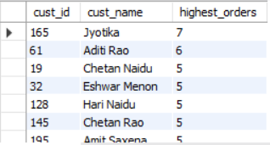
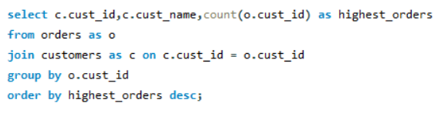
Queries & summaries
1️. Customer Insights
How many unique customers have placed orders?
Which customers have placed the highest number of orders?
Summary :
The first query shows that there are 156 unique customers who placed orders.
The query shows the customers have placed highest number of orders by joining orders and customers table.
by using aggregated function to calculate total orders per customer ,and sorted in order by the highest orders
output in descending order.
From the total customers, Jyotika and Aditi Rao placed the highest number of orders.

Slide 8

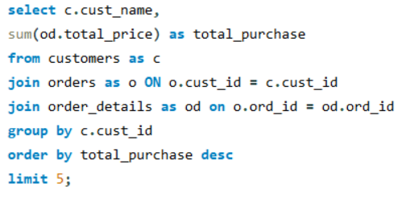
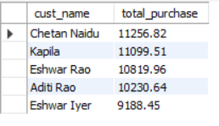
2. Who are the top 5 customers by total purchase amount?
Summary :
Some customers(like Chetan Naidu, Kalyan, and Eshwar Rao) spend significantly more than others.
Total purchase values vary widely – showing a mix of high- value and low value customers.

Slide 9
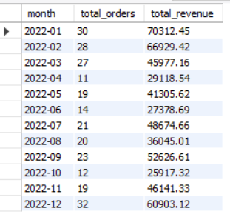
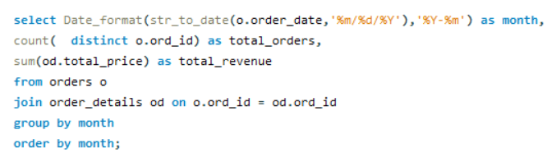
3. What are the monthly trends in order volume and revenue?
Summery :
The monthly trends show that order volume and revenue are highest during December, January, and February.
Both order counts and total revenue peak at the end and the beginning of the year, indicating strong
seasonal demand during these months.

Slide 10
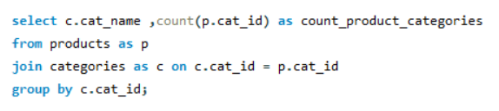
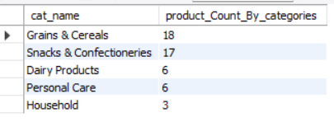
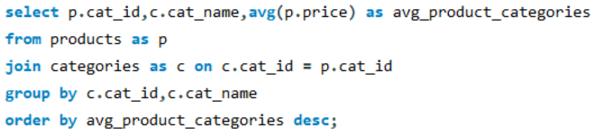
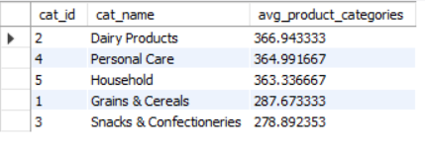
Product Performance
4. How many products exist in each category?
5. What is the average price of products by category?
Summary :
The Grains & Cereals category contains the highest number of products, followed by snacks & Confectioneries.
Household and Personal Care have comparatively fewer products in their categories .
In terms of Pricing, Dairy products have the highest average price, while Snacks & confectioneries show the lowest average
Price. This indicates that Dairy products are generally more expensive, whereas snacks& confectioneries are the most budget friendly category.

Slide 11
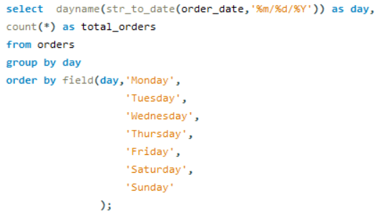
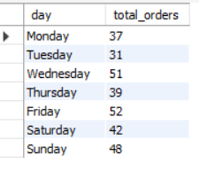
6. How do order patterns vary across weekdays and weekends?
Summary :
The data shows that order volume vary across week, Monday and Friday have the highest orders,
And ,while Tuesday sees the lowest. Weekends also remain strong with both Saturday and Sunday
Showing higher than average activity.

Slide 12
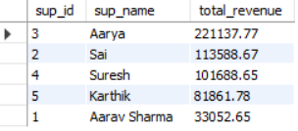
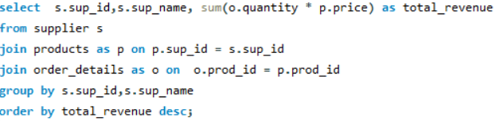
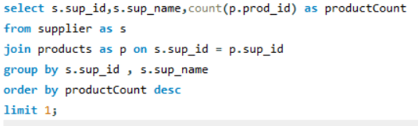

Supplier Contribution
7. Which suppliers contribute the most to total product sales (by revenue)?
Which supplier provides the most products?
Summary :
The Query shows Total revenue generated by the each supplier.it does by the joining the suppliers, products and order details
tables. The results are grouped by supplier and sorted in descending order of revenue.
The query counts how many products each supplier offers. It joins the suppliers and products tables , groups by supplier,
and orders them based on the number of products supplied.
Supplier Aarya is the leading supplier both in terms of Highest total revenue, and Most products supplied.

Slide 13
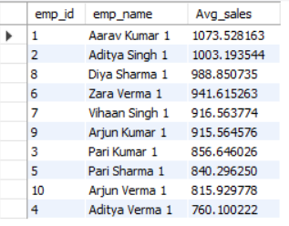
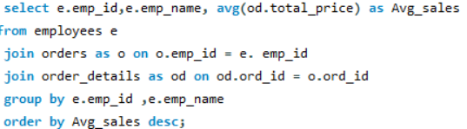
8. What is the average order value handled per employee?
Summary :
The query shows the Average sale generated by the order value handled per employee by joining the
employees, Orders and order details table .The results are grouped by employee ID and employee name
and sorted in order by average sales.

Slide 14
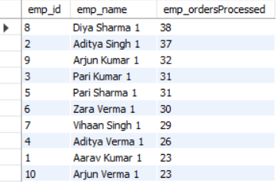
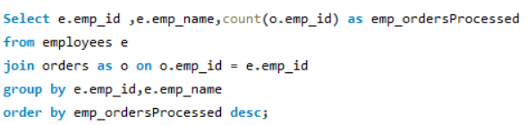
9. Which employees have handled the most orders?
Summary :
The query Ranks employees by the number of orders they handled . The results show that Diya Sharma Processes the more orders, Followed closely by Aditya Singh and Arjun Kumar ,while others handled moderate volumes.

Slide 15
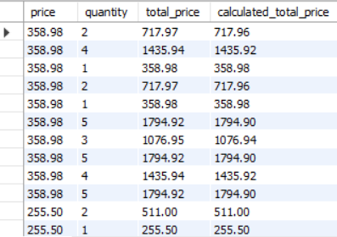

10. What is the relationship between quantity ordered and total price?
Summary :
The query shows that the relationship between the quantity and total price ,by joining the products and order details tables.
The relationship is directly proportional. If quantity doubles total price also doubles.

Slide 16
Final business insights
1.customers
4.Supplier Contribution
A small number of customers contribute
a large share of total revenue.
Some customers order frequently but spend less per order.
Average order value varies a lot between customers.
Few suppliers contributes more products
and revenue.
Pricing and performance vary widely across supplier.
5.Employee Performance
2.Product Performance
Few Employees process more sales ,
order handling is uneven.
Performance Variability suggests training needs.
Low performing items and keep only best selling products.
High volume items keep maximum stock.
Certain categories and products dominates Sales.
6.Order Details Deep Drive
3.Sales & Order Trends
Strong linear link between quantity and revenue.
Price variations indicates discounts or
updated pricing .
Clear peak sales days and monthly patterns.
If sales drop in certain months ,those months
need better marketing or offer.

Slide 17
Final Business Recommendations
Introduce loyalty cards or point based system.
Negotiate better deals for high-volume items and reduce ordering of slow-moving or non-profitable items.
Maintain multiple suppliers to prevent delays.
Place fast-moving items in visible areas.
Keep frequently bought items at the back items increase store walk-through.
Sales trends analyse monthly revenue and order trends.
Provide training on customer services.

Slide 18
Conclusion (Key finding overall)
Top customers drive most revenue, and certain categories/products consistently outperform others in both sales volume and revenue.
Monthly and weekday analysis reveals peak periods (January, February, December, Wednesday, Friday, Weekdays ),
helping optimise marketing and staffing.
High Performing suppliers and employees are identified, enabling better inventory planning, supplier management, and workforce allocation.
The results highlight the top performing products, the most active customer segments, and monthly sales trends.
And some employees handled more orders than others , showing differences in workload and efficiency.

Slide 19
Challenges to Over Come
Understanding table relationships and applying correct joins.
Ensuring data consistency with foreign key constraints.
Handling aggregation across joined tables.
Extracting time-based trends from date (especially if in VARCHAR format).
Vary across the data.

Slide 20

THANK YOU

